Slide 1
Grocery management system in C
Shruthi K

Slide 2
Contents
INTRODUCTION
OBJECTIVE
FLOW CHART
DESCRIPTION
FEATURES
CONCLUSION

Slide 3
Introduction
The Grocery List Management program is a simple console-based application written in C that allows users to manage a grocery shopping list. It provides functionalities to add, display, edit, and remove grocery items from the list, as well as save the list to a file and calculate the total value of items.

Slide 4
OBJECTIVE
The objective of the Grocery Management System code is to create a console-based application that helps users efficiently manage their grocery shopping lists. The code provides a set of features and functionality to achieve this objective. Here are the primary objectives of the code:
List Management: Allow users to create and maintain a list of grocery items. Users can add, display, edit, and remove items from the list.
File Storage: Enable users to save their grocery lists to a file and load them from a file. This feature helps users keep a record of their shopping lists for future reference.
Total Calculation: Provide the ability to calculate the total value of all items in the grocery list. This helps users keep track of their estimated expenses.
Memory Management: Dynamically allocate and manage memory for the grocery list, ensuring that the program can handle a variable number of items without wasting memory.
Error Handling: Implement error handling for memory allocation and file operations to ensure the program's robustness and user-friendly experience.
User-Friendly Interface: Present a menu-driven interface that allows users to interact with the program easily. Users can select options from the menu to perform various actions on their grocery lists.
Convenience: Simplify the process of creating and managing grocery lists, making it more organized and efficient for users.
In summary, the primary objective of this code is to create a practical and user-friendly grocery list management system that simplifies the task of creating, organizing, and maintaining grocery lists while providing essential features for managing and tracking items.

Slide 5
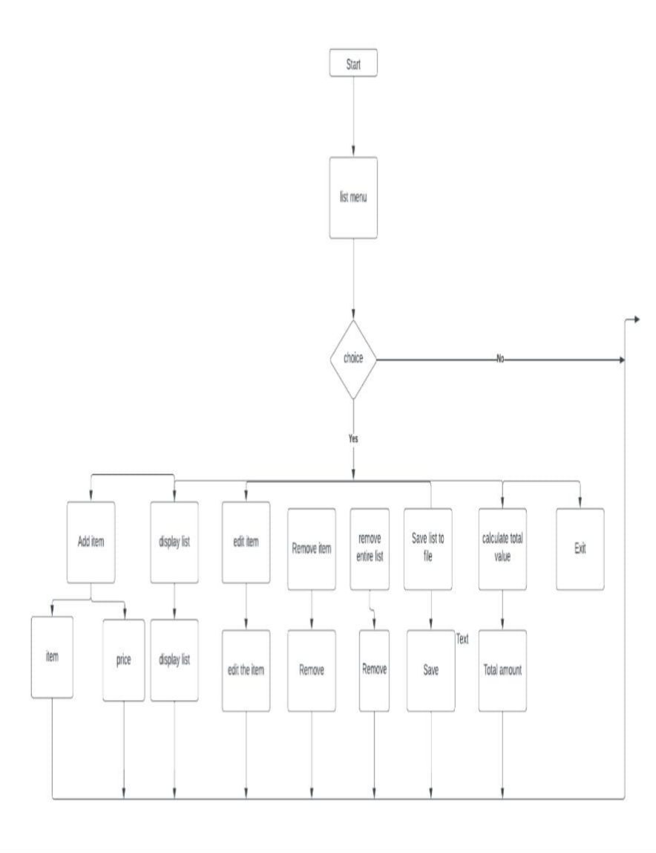
FLOWCHART

Slide 6
DESCRIPTION
The Grocery List Management project is a command-line program developed in C that provides users with a simple and effective way to manage their grocery shopping lists. This program allows users to perform various operations on their grocery lists, such as adding, displaying, editing, and removing items. Additionally, it supports the essential features of saving and loading grocery lists to and from a text file.

Slide 7
FEATURES
Add Item: Users can add a new grocery item to the list by providing its name and price.
Display List: The program displays the current grocery list, including item names and prices.
Edit Item: Users can edit an existing item in the list by specifying its index and providing a new name and price.
Remove Item: Users can remove a specific item from the list by specifying its index.
Remove Entire List: Users can clear the entire grocery list.
Save List to File: The program allows users to save their grocery list to a file named "grocery_list.txt."
Load List from File: Users can load a previously saved grocery list from the "grocery_list.txt" file.
Calculate Total Value: The program calculates and displays the total value of all items in the list.
Exit: Users can exit the program.

Slide 8
CONCLUSION
This C program provides a basic but functional grocery list management system. Users can add, edit, display, and remove items from their grocery list, making it a handy tool for keeping track of shopping needs. The use of dynamic memory allocation and file handling adds robustness to the program's functionality.

